Slide 1
ENERGY AUDIT CONDITIONAL GRANT RMK-12 FOR INDUSTRIAL AND COMMERCIAL SECTOR
(GENERAL INFORMATION)

Slide 2

01
OVERVIEW OF SEDA
02
INTRODUCTION
03
ELIGIBILITY
TABLE OF
CONTENT
04
TERMS AND CONDITIONS
05
BENEFITS
06
APPLICATION PROCESS
07
ACHIEVEMENTS EACG RMK-11
08
CASE STUDY

Slide 3
01
To advise the Minister & Government Entities on all matters relating to sustainable energy
Overview
of SEDA
02
To promote & implement national policy objectives for renewable energy
03
To promote, stimulate, facilitate and develop sustainable energy
  SEDA was established on 1st September 2011 under the SEDA Act 2011 [Act 726] with some of the following functions:
04
To implement, manage, monitor & review the Feed-in Tariff (FiT) system
05
To implement sustainable energy laws and recommend reforms to such laws to the Federal Government
06
To promote private sector investment in sustainable energy sector
07
To act as focal point on matters relating to sustainable energy & climate change matters relating to energy

Slide 4
TEAM STRUCTURE
Members of Authority
Chief Executive Officer
Special Unit
Legal Unit
Integrity Unit
Internal Audit Unit
Strategic Planning and
Communications
Department
Chief Strategic Officer
Operation and Technical
Services
Department
Corporate Services
Department
Market Operations Division
Finance Division
Strategic Planning Division
Technical Development and
Facilitation Division
Human Resource and
Administration Division
Strategic Communications
Division
Digital Services Division
Notes:
To date, below portrays no of post in each division/unit, filled for each dept for reference:
Total
Post Available - 91
Filled - 77
Vacant – 14
Below according to each department:
CEO’s Office
Post Available - 14
Filled -12
Vacant – 2
Strategic Planning & Communications (SPC)
Post Available - 20
Filled -15
Vacant – 5
Operations & Technical Services (OTS)
Post Available - 29
Filled - 24
Vacant – 5
Corporate Services (CS)
Post Available - 28
Filled - 26
Vacant – 2

Slide 5



The Energy Audit Conditional Grant (EACG) is an energy efficiency programme under the 12th Malaysia Plan (RMK-12) for the implementation year of 2021-2025.
Grant will be given to the building owner
Building owner must appoint Energy Service Companies (ESCO) to carry out energy audit activities
Building owner will use the grant for energy audit purposes
Grant
Industrial : up to RM 100,000
Commercial : up to RM 60,000
INTRODUCTION
Approval
Applicant
Auditor
Executing Ministry
ESCO
Energy Service Company
Must be registered with
ST (Peninsular & Sabah)
EIU (Sarawak)
Building
or
Installation Owner
Coordinator
Implementing Agency

Slide 6



ELECTRICITY USAGE
NOT A PREVIOUS EACG APPLICANT
ELIGIBILITY
Open to any commercial and industrial installation with minimum monthly consumption
100,000 kWh/month
Not eligible for any installation which has received a grant from the previous Energy Audit Conditional Grant
AGREED TO APPOINT PERSON IN CHARGE

Slide 7












ENERGY AUDIT PHASE
(2 months)
IMPLEMENTATION PHASE
(3 years)
Must appoint
REEM or PIC
Reporting:
Every 3 months to SEDA
Every 6 months to EMIS
TERMS AND CONDITIONS
Energy Audit
Implementation Cost
>
Grant Applied
=
2 months
Target savings (%) are based on Energy Audit Report
REEM : Registered Electrical Energy Manager
EMIS : Energy Management Information System

Slide 8



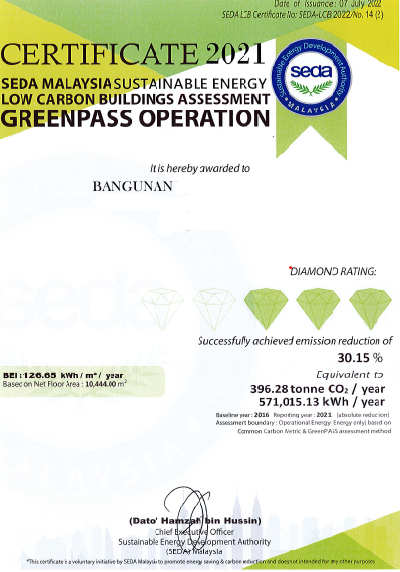


Identify Potential Energy Savings
Financial Assistance
(Grant)
BENEFITS
FREE Facilitation
FREE Training
FREE Awareness
FREE Recognition

Slide 9
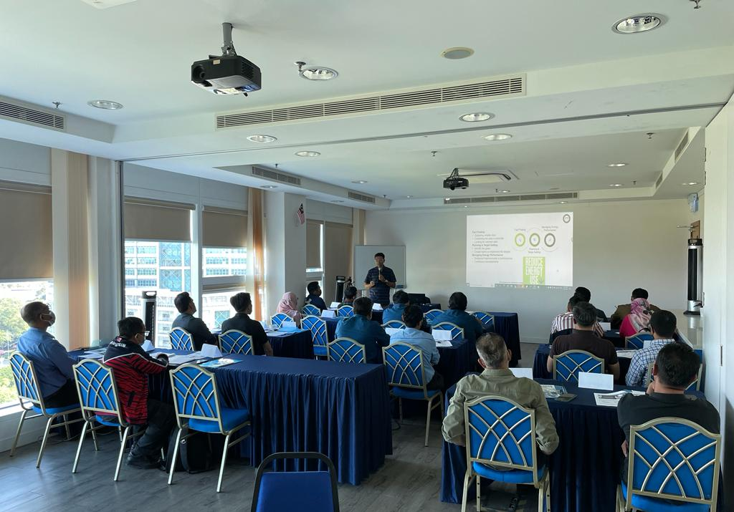
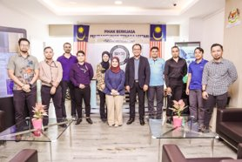
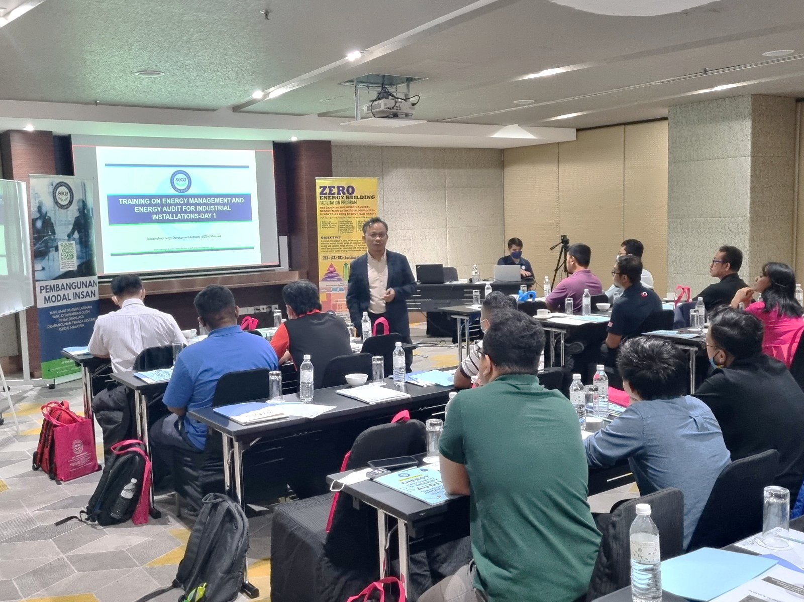
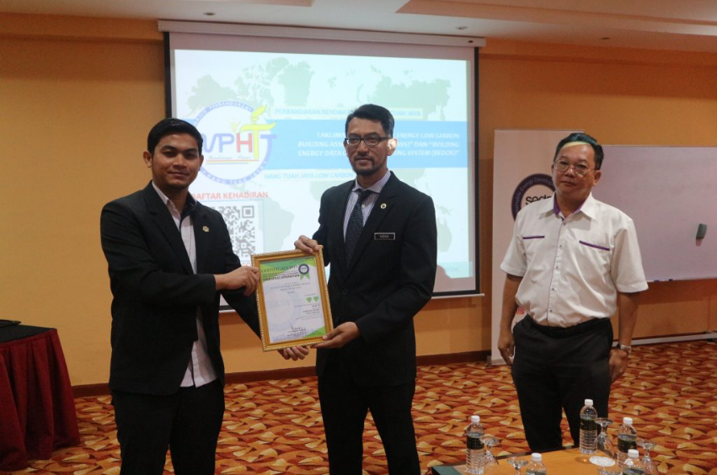
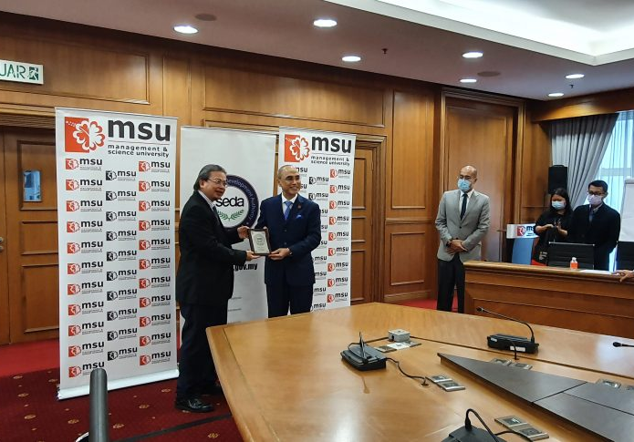
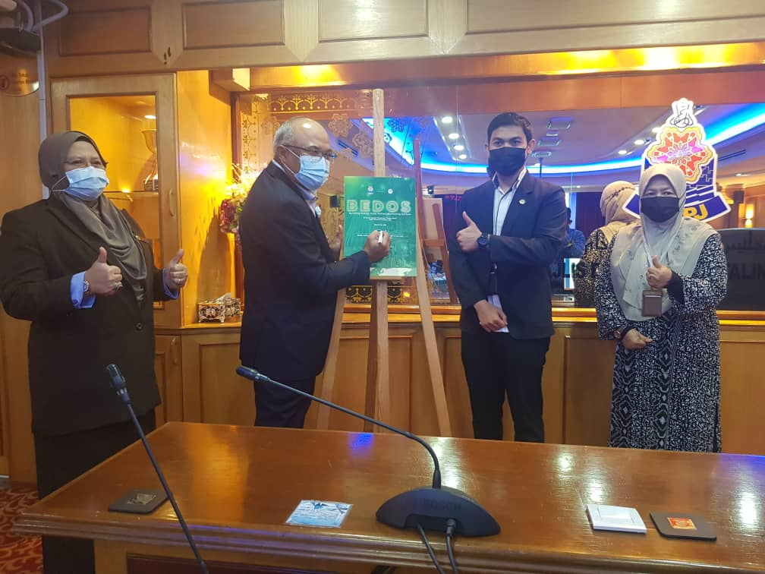
ENERGY MANAGEMENT & ENERGY AUDIT TRAINING
BENEFITS
RECOGNITION - GreenPASS Certification

Slide 10










Energy Audit
starts here
Approval
Offer Letter
Contract Document
20% Grant
Evaluation Comm.
Technical Comm.
Steering Comm.
Sign and return in 7 days
Sign and return in 1 month
Invoice or Surat Permohonan Penyaluran Geran
OFFER LETTER
WHOLE PROCESS
ESCO appointment ends here
End of Contract
Monitoring and
Implementation
80% Grant
Energy Audit Report
Every 3 months
Every 6 months
(EMIS)
Invoice or Surat Permohonan Penyaluran Geran
ESCO
Applicant
SEDA
Investment > Grant
Achieved % savings

Slide 11

Installation Review
CASE STUDY (Industrial Sector)
Installation Name | Factory A
Building Location | Northern Region
Nature of Business | Plastic Manufacturer
Electricity Tariff Category | E2
Annual Electricity Consumption (kWh) 2021 | 5,451,816.00 kWh

Slide 12
Load Apportioning
CASE STUDY

Slide 13
Proposed ESM from Energy Audit Findings
CASE STUDY
Energy Saving Measurement (ESM) | Energy Savings (kWh) | Cost Savings (RM) | System Savings (%) | Overall Savings (%) | CO2 Savings (ton/year)
No Cost Measures
ESM 1 – Adjust the VFD frequency setting to 45Hz for dust collector P5 & P6 blower fan | 66,689.56 | 23,674.79 | 12.48 % | 1.22 % | 42.61
Low & Medium Cost Measures
ESM 2 – Awareness Training | 16,500.00 | 5,857.50 | - | 0.30 % | 10.54
ESM 3 – Leak test and repair leak for compressed air system | 12,498.90 | 4,437.11 | 5.09 % | 0.23 % | 7.99
ESM 4 – Install new VFD to reduce speed for dust collector P3 | 40,789,84 | 14,480.39 | 7.63 % | 0.75 % | 26.06
ESM 5 – Replace existing AHU motor with higher | 16,027.92 | 5,689.91 | 1.63 % | 0.29 % | 10.24
High Cost Measures
ESM 6 – Separate the chilled water system loop for production and air-conditioning system | 231,876.00 | 82,315.98 | 23.63 % | 4.25 % | 148.17
TOTAL | 384,382.21 kWh | RM 136,455.69 | - | 7.05 % | 245.62

Slide 14
Implemented ESM
CASE STUDY
Energy Saving Measurement (ESM) | Investment Cost (RM) | Baseline Consumption (kWh) | Current Consumption (kWh) | Annual Cost Savings (RM) | Annual System Savings (%)
No Cost Measures
ESM 1.1 – Adjust the VFD frequency setting to 45Hz for dust collector P5 blower fan | 0 | 18.45 | 14.04 | RM 18,092.34 | 23.9 %
ESM 1.2 - Adjust the VFD frequency setting to 45Hz for dust collector P6 blower fan | 0 | 25.54 | 15.37 | RM 41,723.15 | 39.8 %
Medium Cost Measures
ESM 4 - Install new VFD to reduce speed for dust collector P3 | 5,000.00 | 16.60 | 14.71 | RM 7,753.86 | 11.4 %
TOTAL | RM 5,000.00 | - | - | RM 67,569.35 | -

Slide 15
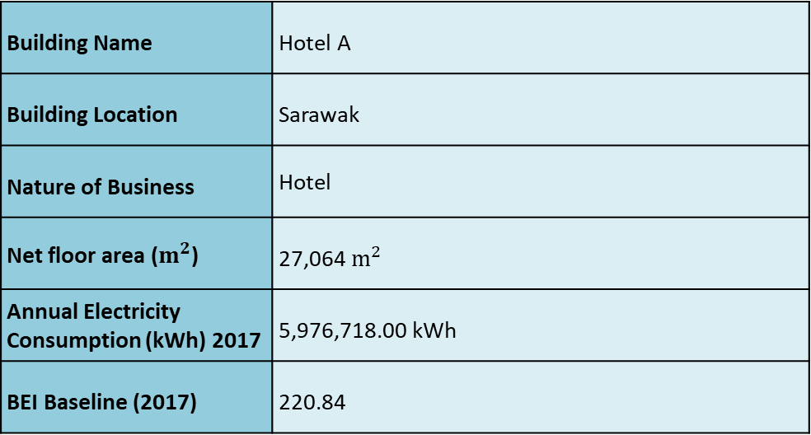
Building Review
CASE STUDY (Commercial Sector)
Building Name | Hotel A
Building Location | Sarawak
Nature of Business | Hotel
Net floor area ($m^{2}$) | 27,064 $m^{2}$
Annual Electricity Consumption (kWh) 2017 | 5,976,718.00 kWh
BEI Baseline (2017) | 220.84

Slide 16
CASE STUDY
Building Load

Slide 17
Proposed ESM from Energy Audit Findings
CASE STUDY
Energy Saving Measurement (ESM) | Energy Savings (kWh) | Cost Savings (RM) | % Impact | CO2 Savings
No Cost Measures
ESM 1 – Motor operation efficiency check for AHU | 9,775.00 | 2,187.55 | 0.16 % | 6.83
ESM 2 – Increase chilled water set point at Chiller 1 | 33,945.00 | 7,597.00 | 0.57 % | 23.56
Low & Medium Cost Measures
ESM 3 – Reschedule 3 nos of corridor AHU operating hours & install timer | 67,871.00 | 15,189.49 | 1.14 % | 47.1
ESM 4 - Retrofitting Fluo T8 18W to LED surface mounted 12W | 21,304.00 | 4,767.91 | 0.36 % | 14.78
ESM 5 - Retrofitting PAR38 Halogen 120W to PAR LED 17W | 15,833.00 | 3,879.12 | 0.26 % | 10.99
ESM 6 - Installation of VSD at Chilled Water Pumps (CHWP) 1 | 32,779.00 | 7,335.96 | 0.55 % | 22.75
ESM 7 - Establish of Sustainability Energy Management Systems (SEMS) | 107,581.00 | 30,476.91 | 1.80 % | 74.66
High Cost Measures
ESM 8 - Retrofitting pf existing E14 Incandescent 25W to LED 2.3W | 36,445.00 | 8,929.10 | 0.61 % | 25.29
ESM 9 - Retrofitting of existing M16 Halogen 50W to M16 LED 5W | 98,952.00 | 22,145.38 | 1.66 % | 68.67
ESM 10 - Retrofitting of existing chiller 3 to Energy efficient chiller | 554,543.00 | 124,106.73 | 9.28 % | 384.85
TOTAL | 979,028.00 kWh | RM 226,615.15 | 16.38 % | 679.49

Slide 18
Implemented ESM
CASE STUDY
Energy Saving Measurement (ESM) | Investment Cost (RM) | Energy Savings (kWh) | Cost Savings (RM)
No Cost Measures
ESM 1 – Motor operation efficiency check for AHU | 0 | 9,775.00 | 3,568.00
ESM 2 – Increase chilled water set point at Chiller 1 | 0 | 47,524.00 | 17,346.00
Low & Medium Cost Measures
ESM 3 – Reschedule 3 nos of corridor AHU operating hours & install timer | 270.00 | 67,871.00 | 15,189.49
ESM 4 - Retrofitting Fluo T8 18W to LED surface mounted 12W | 1,976.00 | 21,304.00 | 4,767.91
ESM 5 - Retrofitting of existing M16 Halogen 50W to M16 LED 5W | 2,984.00 | 15,833.00 | 3,879.00
High Cost Measures
ESM 6 - Retrofitting pf existing E14 Incandescent 25W to LED 2.3W | 14,826.00 | 554,543.00 | 124,107.00
ESM 7 - Retrofitting 208 nos of FL to LED | 13,064.00 | 6,149.00 | 1,537.00
TOTAL | RM 33,119.00 | 772,998.84 kWh | RM 170,393.18
Percentage Energy Savings Reported:
12.1 %

Slide 19
SUCCESSFUL STORY OF EACG RMK-11 (COMMERCIAL SECTOR)
EACG RMK-11 (INDUSTRIAL SECTOR):
Energy Savings (kWh) Reported
241,132,323 kWh
≈ RM 95,130,000
*Data as of Dec 2022

Slide 20
SUCCESSFUL STORY OF EACG RMK-11 (COMMERCIAL SECTOR)
EACG RMK-11 (COMMERCIAL SECTOR):
Energy Savings (kWh) Reported
≈ RM 105,077,190
*Data as of Dec 2022

Slide 21




8 physical seminar/promotions
11 trainings
EACG
120 quota for industrial
94 quota for commercial
For 2024
RM 18.8 million approved

Slide 22

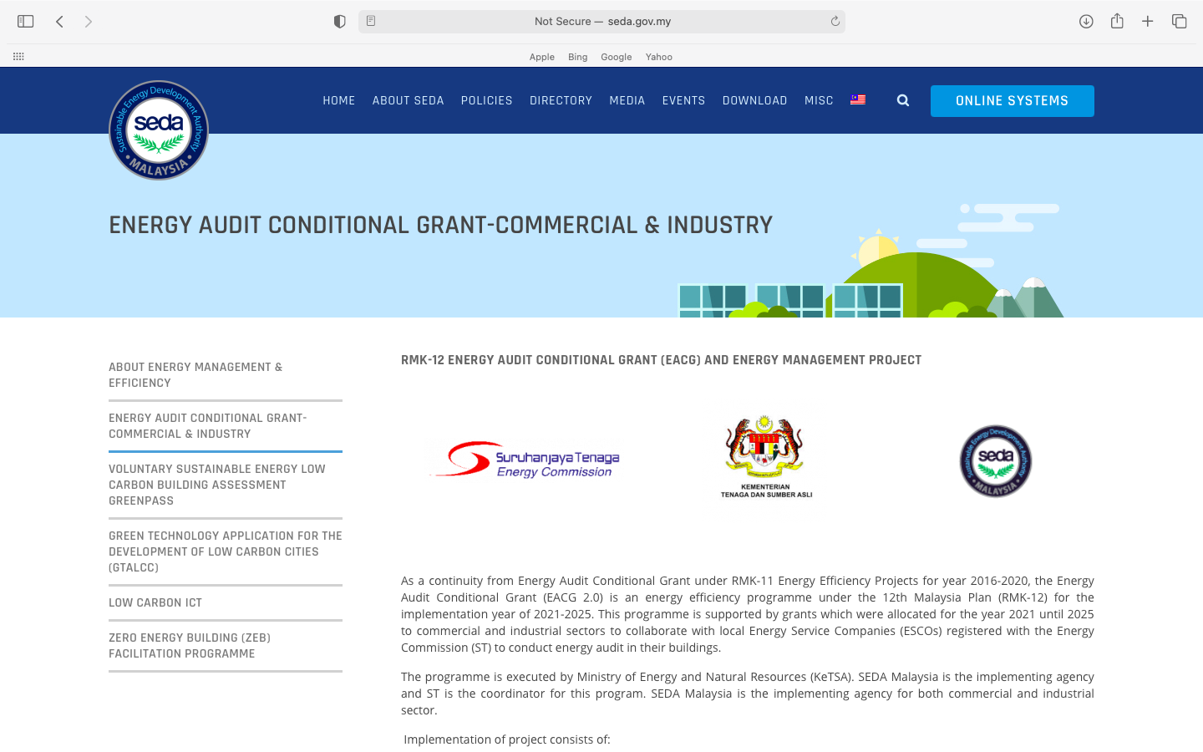

Website: www.seda.gov.my/eagrant
FOR
INQUIRIES
OR
Contact us at:
Officer | Email | Number
Zulkhairee | Zulkhairee@seda.gov.my | 018-9485525
EACG | eacg@seda.gov.my | 03-88705800

Slide 23

6th ISES2024 – PROPOSED CONTENTS AND SPEAKERS
The 6th International Sustainable Energy
Summit (ISES) 2024

Slide 24
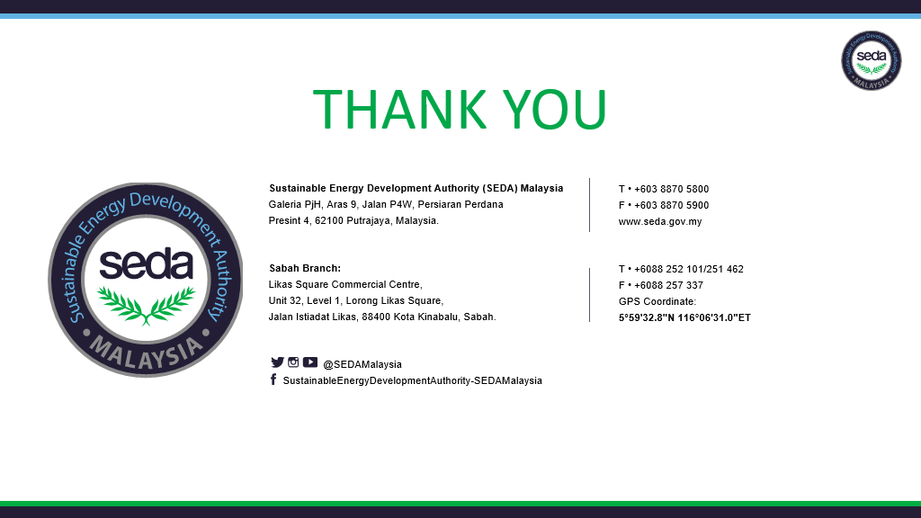

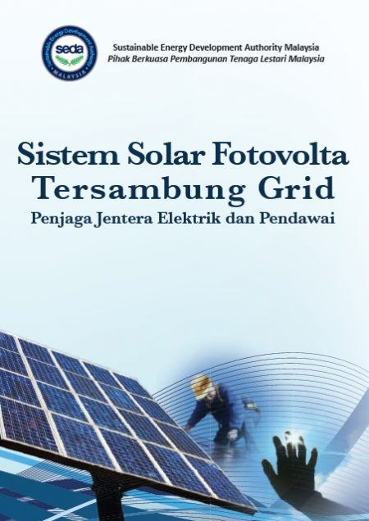

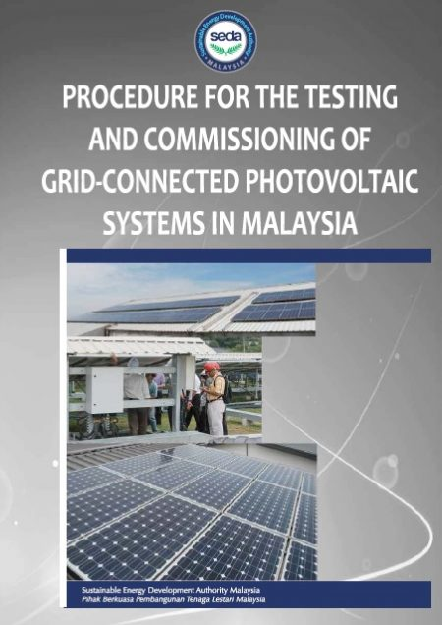
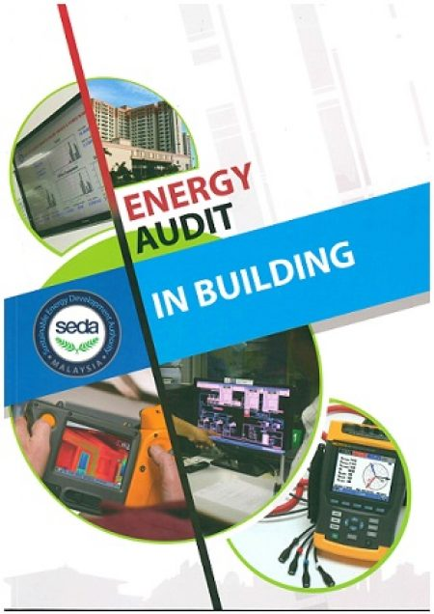


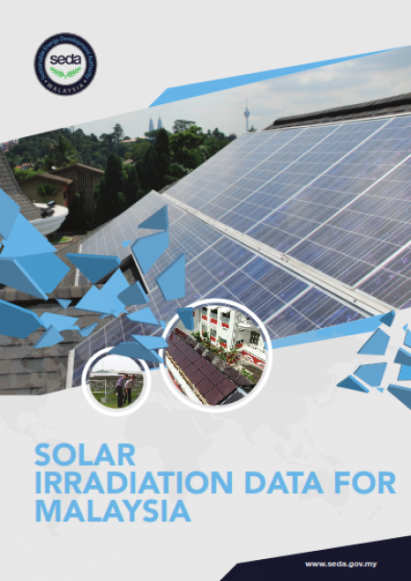


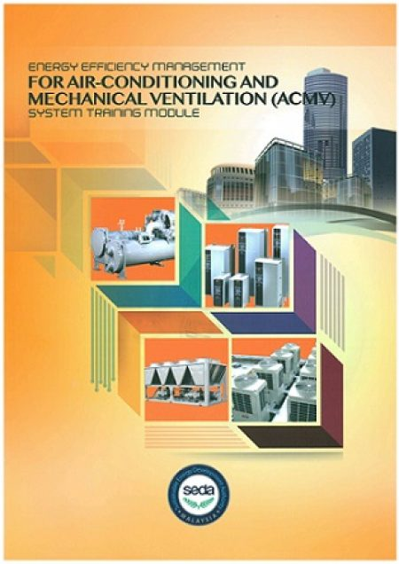

RE & EE Training Modules

